Slide 1
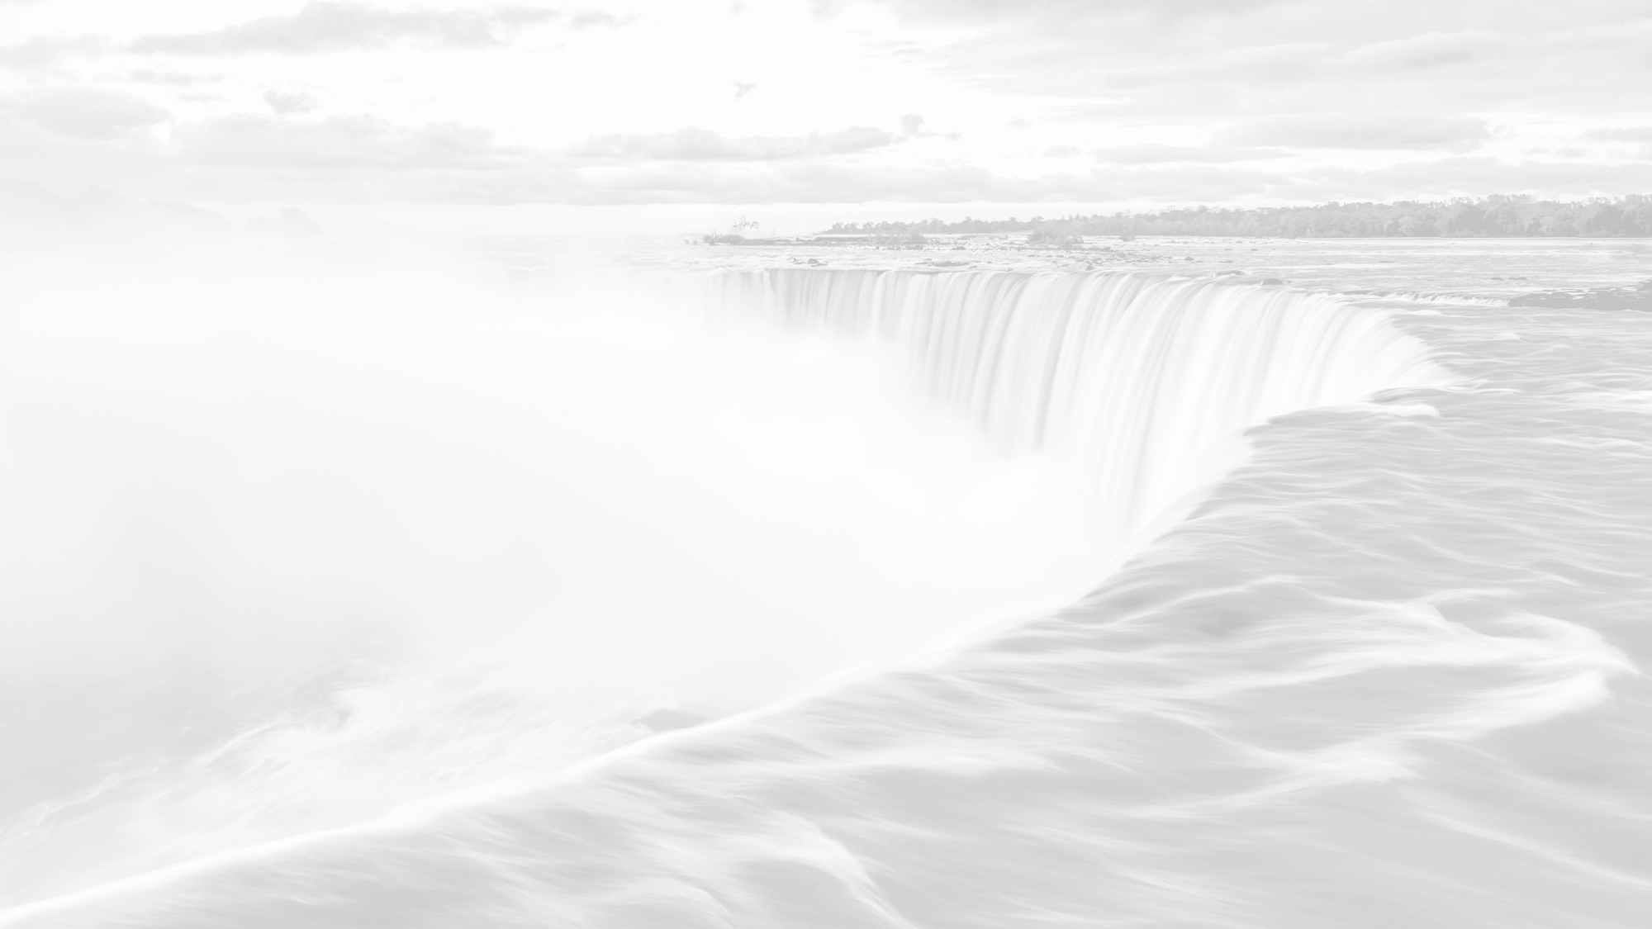
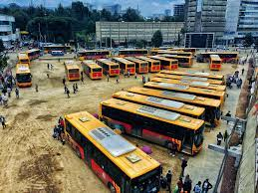
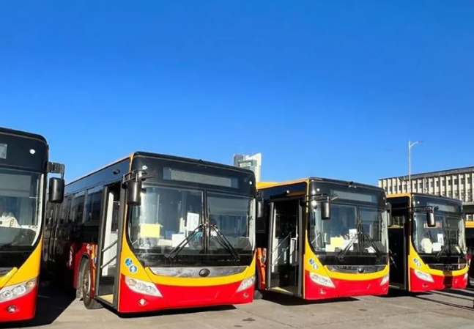
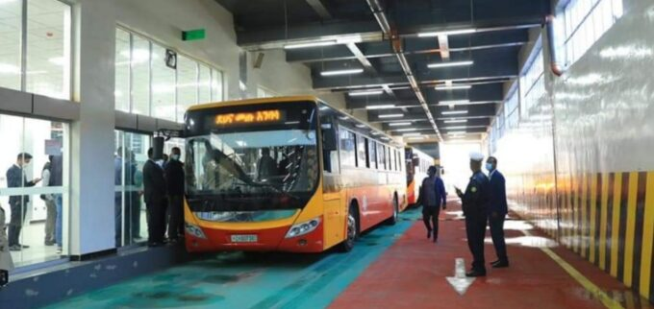

Modeling and Analysis of Bus Scheduling Systems of Urban Public Bus Transport
Anbessa City Bus Service Enterprise (ACBSE)
Group 2
Ameyaw Kofi, Erique Wilson, Nematov Abdulkhodiy, Shrestha Kriti Bahadur

Slide 2
Global urban passenger demand reached 8 trillion passenger-kilometers in 2022
And…
is projected to more than double to 17 trillion passenger-kilometers by 2050

Slide 3
Problem Understanding
690 Buses
600 small
90 large
110 Routes
93 significant
17 low demand
640.000
Passengers
Daily Demand: 640.000 Riders
Buses exceed capacity (125% ) IN Peak Hours, affecting service quality. The average 640,000. daily passenger load
Low occupancy (below 20%) during durig off peak, resource wastage.
Fixed schedule not match demand variability. Daily coverage: 78,963 km, with 5,500 trips.
Major expenses stem from fuel, maintenance, and depreciation, impacting overall efficiency.
Overcrowding during Peak Hours
Inefficient Resource Allocation
Underutilization during Off-Peak Hours
High Operating Costs

Slide 4


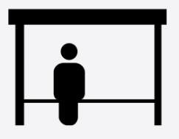

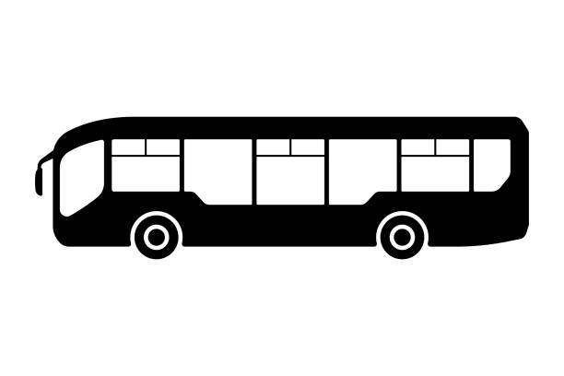

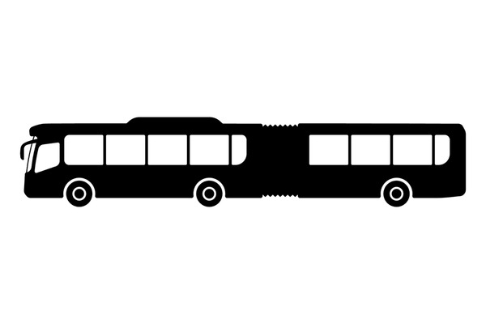
Vehicle Scheduling Problem
RTT
Shift 1
Morning
Shift 2
Noon
Shift 4
Afternoon
Shift 3
Night
ST: Shift Time
RTT: Round Trip Time:
T: Trip Factor → ST / RTT
MWT: Max Wait Time: 30 Mins
Time between consecutive departures
BUS T-I
X 600
93 Routes
BUS T-II
X 90
Start and End of Route circuit
Bus Stops
Riders Demand
640.000 Daily Users
Capacity
690 Buses
Cost: Bus Type I : 2 x
Cost: Bust Type II: 3 x
Routes
93 Routes, 138Km avg Length Over 78,000 km traveled daily.
Average Fleet Size: 534 buses daily.
Daily Passenger Volume: 640,000 passengers per day.
Total Number of Routes: 110 routes.
Peak Hour Services: Additional peak hour services are operated on 37 routes.
Average Distance per Bus: 138 km per day.
Average Trips per Bus: 61.50 trips per day.

Slide 5
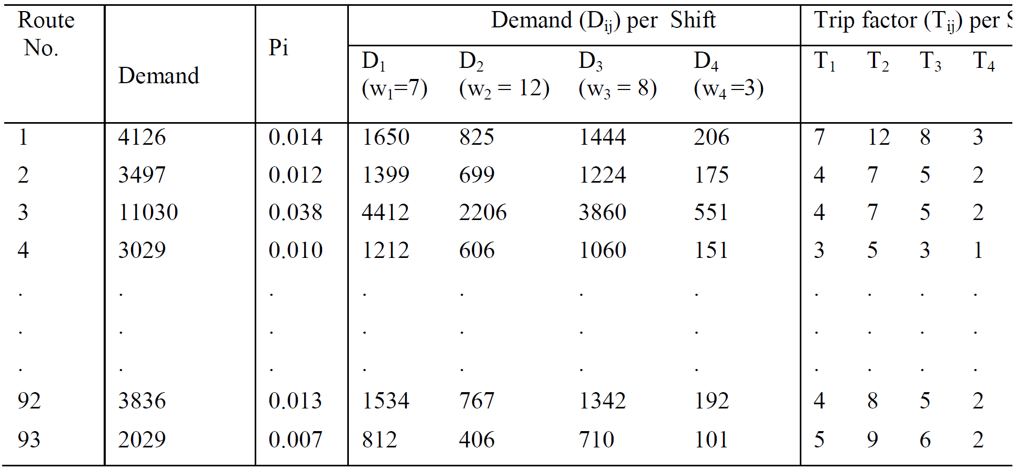
Demand Dataset
Shift | Time Interval | Duration (Min.) | Demand Proportion (%)
Morning Peak | 6:15-9:30 | 195 | 40%
First off-peak | 9:30-15:30 | 360 | 20%
Evening peak | 15:30-19:30 | 240 | 35%
Second off-peak | 19:30-21:00 | 90 | 5%
Total |  | 870 | 100%
Route | D1 | D2 | D3 | D4 | T1 | T2 | T3 | T4
1 | 1650 | 825 | 1444 | 206 | 7 | 12 | 8 | 3
2 | 1399 | 699 | 1224 | 175 | 4 | 7 | 5 | 2
3 | 4412 | 2206 | 3861 | 552 | 4 | 7 | 5 | 2
4 | 1212 | 606 | 1060 | 151 | 3 | 5 | 3 | 1
5 | 1404 | 702 | 1229 | 176 | 5 | 8 | 6 | 2
6 | 443 | 221 | 387 | 55 | 4 | 7 | 5 | 2
7 | 1404 | 702 | 1229 | 176 | 7 | 11 | 8 | 3
8 | 2009 | 1004 | 1758 | 251 | 7 | 11 | 8 | 3
9 | 1814 | 907 | 1588 | 227 | 4 | 7 | 5 | 2
10 | 292 | 146 | 255 | 36 | 6 | 10 | 7 | 3
11 | 497 | 248 | 435 | 62 | 3 | 5 | 3 | 1
12 | 346 | 173 | 302 | 43 | 6 | 10 | 7 | 3
13 | 216 | 108 | 189 | 27 | 5 | 8 | 6 | 2

Slide 6
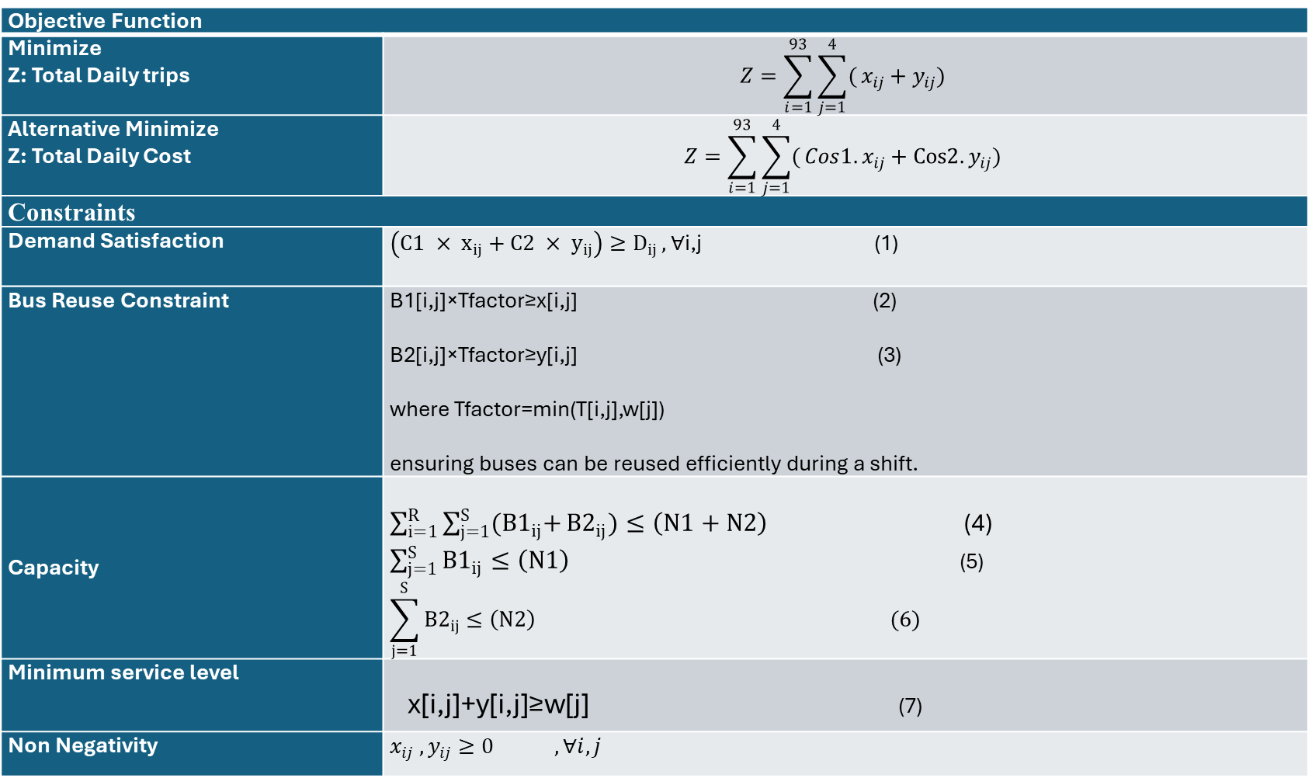
Objective Function
Minimize Z: Total Daily trips | $$Z=\sum_{i=1}^{93}{\sum_{j=1}^{4}{(}x_{ij}+y_{ij}) }$$
Alternative Minimize Z: Total Daily Cost | $$Z=\sum_{i=1}^{93}{\sum_{j=1}^{4}{(}{Cos1.x}_{ij}+Cos2.y_{ij}) }$$
Constraints
Demand Satisfaction | $\left({C1 × x}_{ij}+{C2 × y}_{ij}\right)≥D_{ij },$∀i,j (1)
Bus Reuse Constraint | B1[i,j]×Tfactor​≥x[i,j] (2) B2[i,j]×Tfactor≥y[i,j] (3) where Tfactor=min(T[i,j],w[j]) ensuring buses can be reused efficiently during a shift.
Capacity | $\sum_{i=1}^{R}{\sum_{j=1}^{S}{{(B1}_{ij}+}{B2}_{ij})≤\left(N1+N2\right)}$ (4) $\sum_{j=1}^{S}{{B1}_{ij}}≤\left(N1\right)$ (5) $$\sum_{j=1}^{S}{{B2}_{ij}}≤\left(N2\right) (6)$$
Minimum service level | x[i,j]+y[i,j]≥w[j] (7)
Non Negativity | $$x_{ij} , y_{ij}≥0 , ∀i,j$$
Notes:
Total daily operating cost. Since in the article there is no detail about Costs of operation per Bus Type, per Km, the selected approach is minimizing the number of trips needed to satisfy the Demand
Simply by using a cost factor per trip.
Constraints:
Demand Satisfaction:
This restriction ensures that the aggregated capacity of the available buses is sufficient to satisfy the demand on each route and shift.
Prevents overuse of buses and ensures that the number of buses assigned to a route and shift is sufficient for the required trips:
Fleet Availability: 600 Buses Type I and 90 Buses Type II.
Minimum Service Frequency, or Minimum number of trips per turn, must guaranty an 30 Minutes wait for all routes, where: $$wj= \frac{Total Duration for Shift j}{30 Minutes}$$
Non-Negativity: The number of trips by both bus Type-I and Type-II must be non-negative, as negative trips are not feasible.

Slide 7
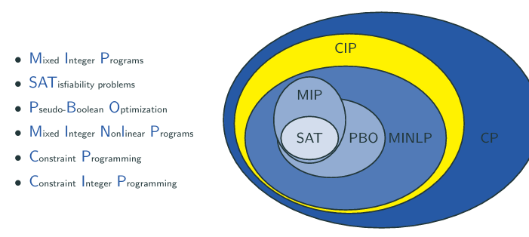
Solver Used

Slide 8
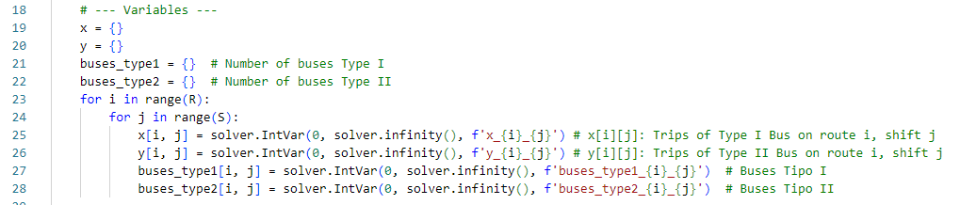
Some Coding Discussion

Slide 9

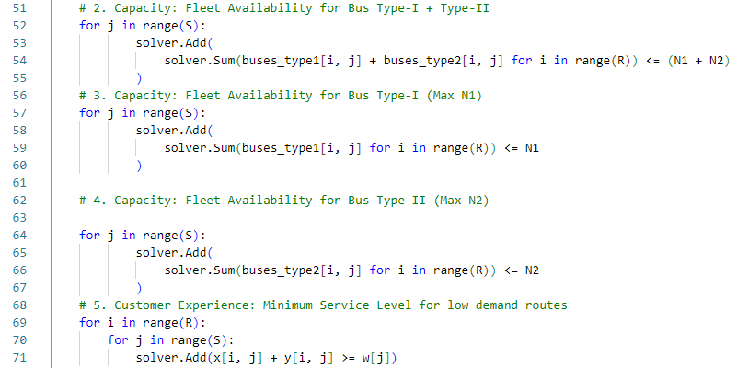
Some Coding Discussion

Slide 10
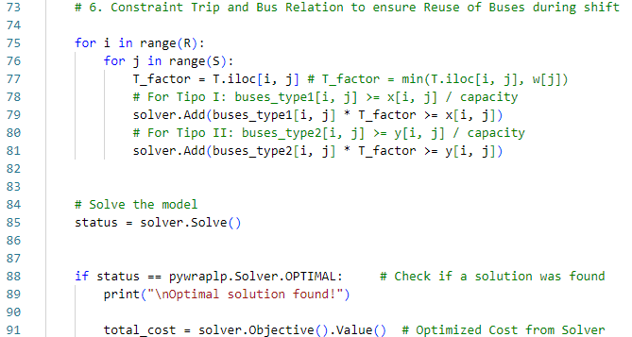
Some Coding Discussion

Slide 11
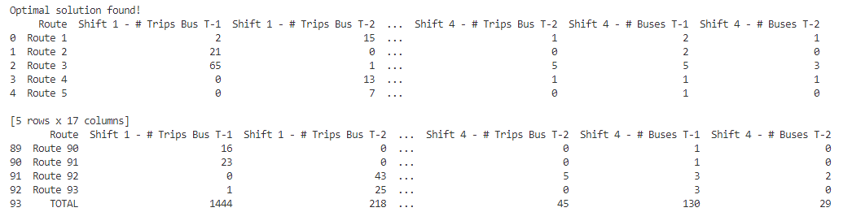
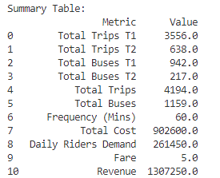
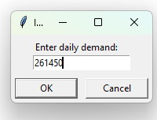
Console Output

Slide 12
Results Dataset

Slide 13
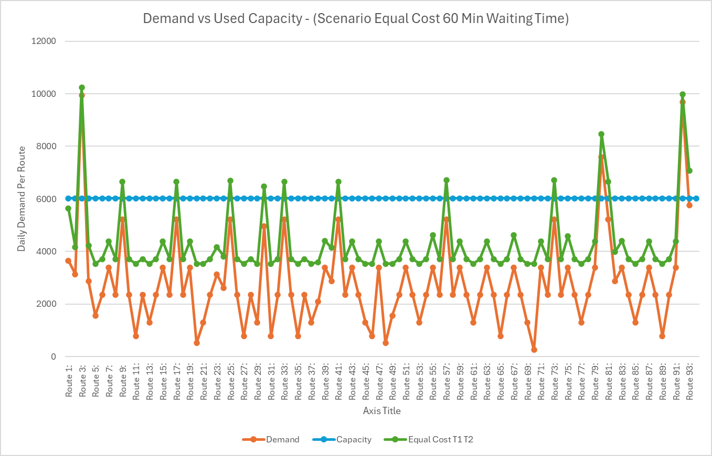

Slide 14
Results Multiple Scenarios
Scenario | Demand (Riders) | Trips T1 | Trips T2 | Total Trips | Buses T1 | Buses T2 | Total Buses | Frequency (Mins) | Total Cost | Fare | Revenue | Profit
1 | 100000 | 5437 | 67 | 5504 | 1092 | 76 | 1168 | 15 | $ 1,107,500.00 | 5 | $ 500,000.00 | $ (607,500.00)
2 | 200000 | 5266 | 475 | 5741 | 1177 | 205 | 1382 | 15 | $ 1,195,700.00 | 5 | $ 1,000,000.00 | $ (195,700.00)
3 | 300000 | 6662 | 162 | 6824 | 1326 | 163 | 1489 | 15 | $ 1,381,000.00 | 5 | $ 1,500,000.00 | $ 119,000.00
4 | 400000 | 7294 | 566 | 7860 | 1525 | 265 | 1790 | 15 | $ 1,628,600.00 | 5 | $ 2,000,000.00 | $ 371,400.00
5 | 500000 | 7711 | 1165 | 8876 | 1677 | 246 | 1923 | 15 | $ 1,891,700.00 | 5 | $ 2,500,000.00 | $ 608,300.00
6 | 550000 | 8586 | 1028 | 9614 | 1714 | 258 | 1972 | 15 | $ 2,025,600.00 | 5 | $ 2,750,000.00 | $ 724,400.00
7 | 100000 | 2774 | 168 | 2942 | 685 | 158 | 843 | 30 | $ 605,200.00 | 5 | $ 500,000.00 | $ (105,200.00)
8 | 200000 | 3188 | 601 | 3789 | 868 | 302 | 1170 | 30 | $ 817,900.00 | 5 | $ 1,000,000.00 | $ 182,100.00
9 | 300000 | 5122 | 205 | 5327 | 1110 | 76 | 1186 | 30 | $ 1,085,900.00 | 5 | $ 1,500,000.00 | $ 414,100.00
10 | 400000 | 5672 | 831 | 6503 | 1336 | 270 | 1606 | 30 | $ 1,383,700.00 | 5 | $ 2,000,000.00 | $ 616,300.00
11 | 500000 | 7076 | 982 | 8058 | 1553 | 290 | 1843 | 30 | $ 1,709,800.00 | 5 | $ 2,500,000.00 | $ 790,200.00
12 | 550000 | 7569 | 1199 | 8768 | 1581 | 356 | 1937 | 30 | $ 1,873,500.00 | 5 | $ 2,750,000.00 | $ 876,500.00
13 | 555000 | 7425 | 1383 | 8808 | 1692 | 340 | 2032 | 30 | $ 1,899,900.00 | 5 | $ 2,775,000.00 | $ 875,100.00
14 | 100000 | 1245 | 584 | 1829 | 510 | 226 | 736 | 60 | $ 424,200.00 | 5 | $ 500,000.00 | $ 75,800.00
15 | 200000 | 2456 | 703 | 3159 | 755 | 270 | 1025 | 60 | $ 702,100.00 | 5 | $ 1,000,000.00 | $ 297,900.00
16 | 300000 | 3893 | 807 | 4700 | 991 | 211 | 1202 | 60 | $ 1,020,700.00 | 5 | $ 1,500,000.00 | $ 479,300.00
17 | 400000 | 4515 | 1493 | 6008 | 1241 | 329 | 1570 | 60 | $ 1,350,900.00 | 5 | $ 2,000,000.00 | $ 649,100.00
18 | 500000 | 6178 | 1497 | 7675 | 1486 | 358 | 1844 | 60 | $ 1,684,700.00 | 5 | $ 2,500,000.00 | $ 815,300.00
19 | 550000 | 7631 | 1083 | 8714 | 1592 | 333 | 1925 | 60 | $ 1,851,100.00 | 5 | $ 2,750,000.00 | $ 898,900.00
20 | 555000 | 7269 | 1412 | 8681 | 1640 | 346 | 1986 | 60 | $ 1,877,400.00 | 5 | $ 2,775,000.00 | $ 897,600.00
21 | 560000 | 6896 | 1700 | 8596 | 1676 | 360 | 2036 | 60 | $ 1,889,200.00 | 5 | $ 2,800,000.00 | $ 910,800.00
22 | 25000 | 711 | 61 | 772 | 375 | 156 | 531 | 120 | $ 160,500.00 | 5 | $ 125,000.00 | $ (35,500.00)
23 | 50000 | 639 | 291 | 930 | 400 | 193 | 593 | 120 | $ 215,100.00 | 5 | $ 250,000.00 | $ 34,900.00
24 | 100000 | 1214 | 382 | 1596 | 495 | 218 | 713 | 120 | $ 357,400.00 | 5 | $ 500,000.00 | $ 142,600.00
25 | 200000 | 2174 | 817 | 2991 | 749 | 328 | 1077 | 120 | $ 679,900.00 | 5 | $ 1,000,000.00 | $ 320,100.00
26 | 300000 | 4132 | 607 | 4739 | 1026 | 290 | 1316 | 120 | $ 1,008,500.00 | 5 | $ 1,500,000.00 | $ 491,500.00
27 | 400000 | 4641 | 1385 | 6026 | 1301 | 317 | 1618 | 120 | $ 1,343,700.00 | 5 | $ 2,000,000.00 | $ 656,300.00
28 | 500000 | 6323 | 1385 | 7708 | 1548 | 360 | 1908 | 120 | $ 1,680,100.00 | 5 | $ 2,500,000.00 | $ 819,900.00
29 | 550000 | 7434 | 1203 | 8637 | 1647 | 360 | 2007 | 120 | $ 1,847,700.00 | 5 | $ 2,750,000.00 | $ 902,300.00
30 | 555000 | 7225 | 1432 | 8657 | 1163 | 347 | 1510 | 120 | $ 1,874,600.00 | 5 | $ 2,775,000.00 | $ 900,400.00
31 | 560000 | 7290 | 1428 | 8718 | 1639 | 360 | 1999 | 120 | $ 1,886,400.00 | 5 | $ 2,800,000.00 | $ 913,600.00
32 | 562000 | 7256 | 1463 | 8719 | 1668 | 360 | 2028 | 120 | $ 1,890,100.00 | 5 | $ 2,810,000.00 | $ 919,900.00

Slide 15
Profit Analysis for Service Level by Wait Time (Bus Frequency, 15', 30', 60', 120' )

Slide 19
Questions…

